Slide 1
Giant Chromosomes
The giant chromosomes are the chromosomes which are very large in size as compared to normal chromosomes.
They are also called as mega chromosomes.
These chromosomes are very long and thick in appearance during metaphase than normal chromosomes.
Hence they are called as Giant chromosomes.
The Giant chromosomes are of two types-
1. Lampbrush chromosome.
2. Polytene chromosome.

Slide 2
1. Lampbrush chromosome
Lampbrush chromosomes were first observed by Walther Flemming in 1882 in the oocytes of Salamander and described by Ruckert in shark oocytes in 1892.
This is a giant chromosome which is found in the oocytes or immature egg of most of the vertebrates such as fishes, amphibians, reptiles and birds also in some insects.
They are generally found in oocytes as the DNA content is very high in these cells. They are formed in response to the active synthesis of mRNA molecules for egg cells.
These chromosomes are not found in mammals.

Slide 3
The characteristic features of Lampbrush chromosomes is that it include fine lateral loops that originate from the chromomeres in the diplotene stage of prophase first of meiosis.
These chromosomes are found in both animal species, vertebrates and invertebrates. So, they can be seen only in the prophase first's diplotene stage of meiosis.
They are generally smaller in size in case of invertebrates than vertebrates. Its lateral loops give it its characteristic lamp brush like appearance.

Slide 4
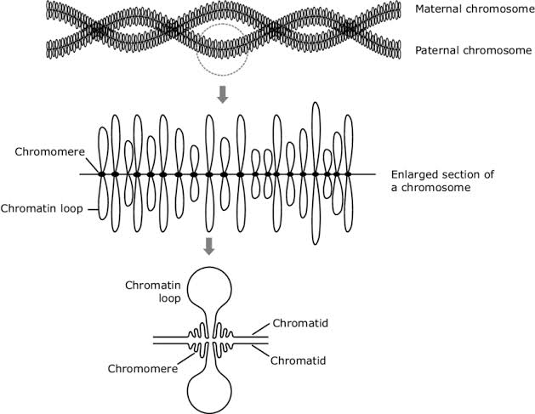
Structure of Lampbrush Chromosomes

Slide 5
The longitudinal axis of chromosome from which loops are arises that are made of a single DNA molecule each. Numerous bead-like structures called chromomeres are arranged in a linear fashion along this axis.
Two symmetrical lateral loops in opposite direction emerge from each chromomere that may expand or contract in response to different environmental conditions.
Biological significance
The loops present in case of lampbrush chromosomes are used in chromosome mapping, particularly those loops that appear at a constant location in the chromosome.
It provides evidence for eukaryotic gene amplification that is needed in the growth phase of oocytes.
This can be used for the analysis in hybridization processes.

Slide 6
Polytene Chromosome
Polytene chromosomes are large chromosomes which have thousands of DNA strands.
Polytene chromosomes were first reported by E.G.Balbiani in 1881.
Polytene chromosomes are found in dipteran flies, for eg. Drosophila.
In insects, they are commonly found in the salivary glands when the cells are not dividing.
Polytene chromosomes are produced when repeated rounds of DNA replication without cell division forms a giant chromosome.
Polytene chromosomes, at interphase, are seen to have distinct thick and thin banding patterns which are called as dark and light bands respectively.

Slide 7
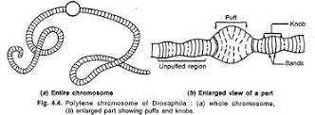
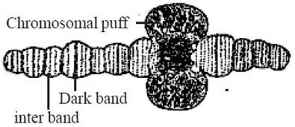
Structure of Polytene Chromosome

Slide 8
Structure of Polytene Chromosome
In insects, polytene chromosomes are commonly found in the salivary glands.
As their presence in salivary gland, they are also called as "salivary gland chromosomes".
The polytene chromosome contains two types of bands namely-
Dark bands and Interbands (light bands).
The dark bands are darkly stained and the inter bands are lightly stained with nuclear stains.
The dark bands contain more DNA and less RNA and interbands contain more RNA and less DNA. The bands of on chromosomes become enlarged at certain times to form swellings called puffs.

Slide 9
The formation of puffs in case of polytene chomosomes is called puffing.
In the regions of puffs, the chromonemata get uncoil and open out to form many loops. The puffing is caused by the uncoiling of individual chromomeres in a band.
The puffs indicate the site of active genes where mRNA synthesis takes place. The chromonemata of puffs give out a series of many loops laterally.
The chromonematal loops appear as rings, they are called Balbiani rings

Slide 10
Biological significance
The banding patterns in polytene chromosomes were originally used to help map chromosomes, identify small chromosome mutations, and in taxonomic identification.
They are now used to study the function of genes in transcription.
The interbands in these chromosomes are involved in the interaction with the active chromatin proteins, nucleosome remodeling, and origin recognition complexes.

